Slide 1
Tunefy
Made By: Cristian & Alejandro

Slide 2
Product Description
- Track your own listening stats which can also be shared with your friends
- Find out what your top artists, songs and albums are
- Easily share new songs with your friends.
- Be recommend new music to you based on your listening history
Notes:
Cristian

Slide 3
Learning Materials
Getting Started with Next.JS
https://nextjs.org/docs/getting-started
Spotify API Documentation:
https://developer.spotify.com
Spotify Authentication Documentation:
https://developer.spotify.com/documentation/general/guides/authorization/code-flow/
Spotify Web API Node
https://www.npmjs.com/package/spotify-web-api-node?activeTab=readme
Next JS refresh token rotation
http://next-auth.js.org/tutorials/refresh-token-rotation
Next.JS Beginner Tutorial Playlist:
https://www.youtube.com/watch?v=A63UxsQsEbU&list=PL4cUxeGkcC9g9gP2onazU5-2M-AzA8eBw
Notes:
Alejandro

Slide 4
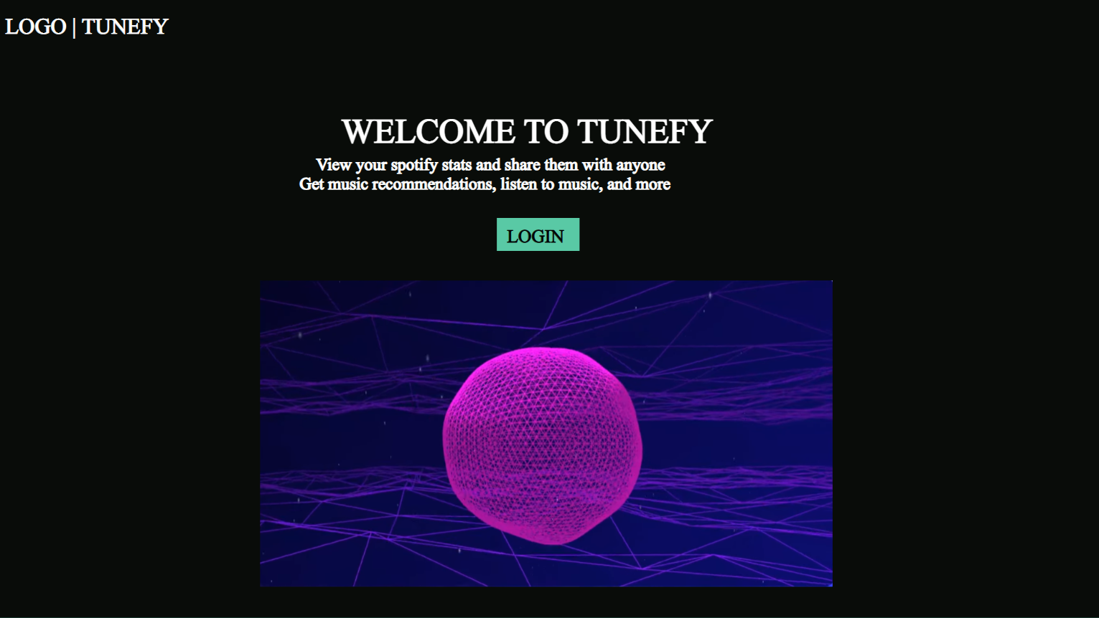
Wireframe - Landing Page
- Login Page
- Moving Visualizer
- Sends to authentication page
Notes:
Cristian

Slide 5
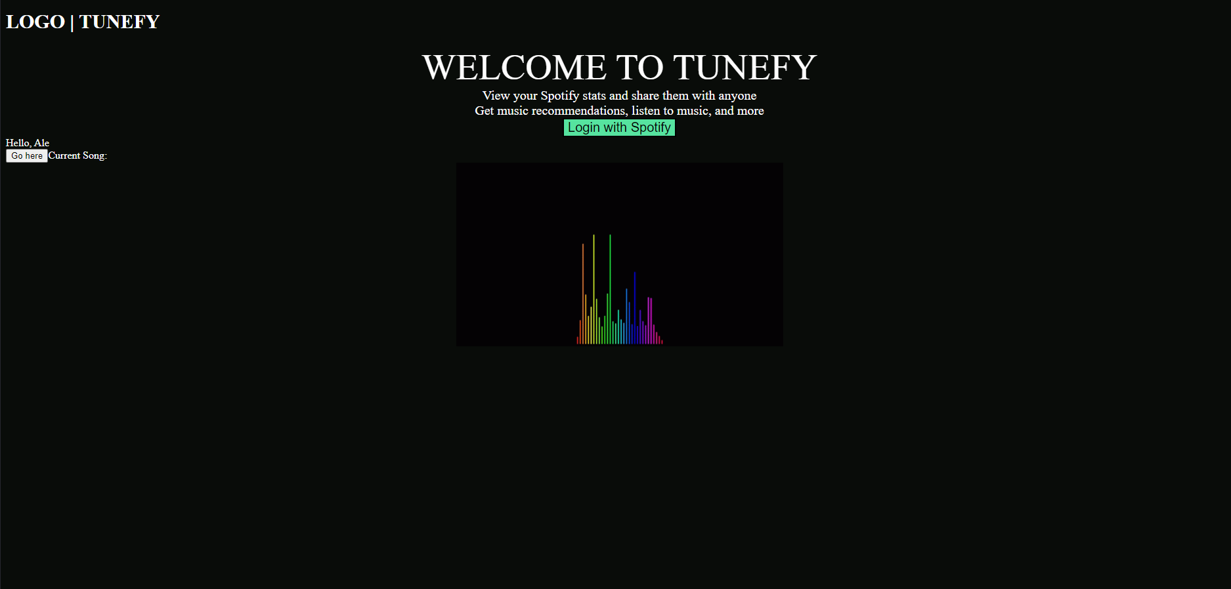
Current Landing Page
Notes:
Alejandro

Slide 6
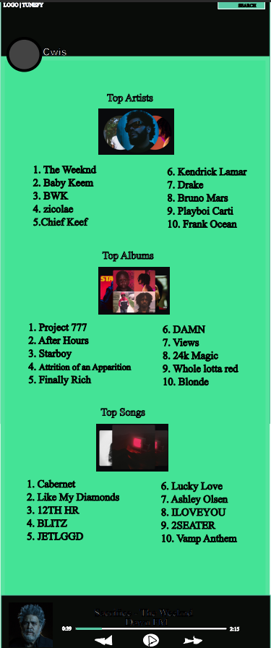
Wireframe - User Profile
- Pull user data from spotify
- Show top artists, albums, and songs
- Music player at bottom
- Search functionality
Notes:
Cristian

Slide 7
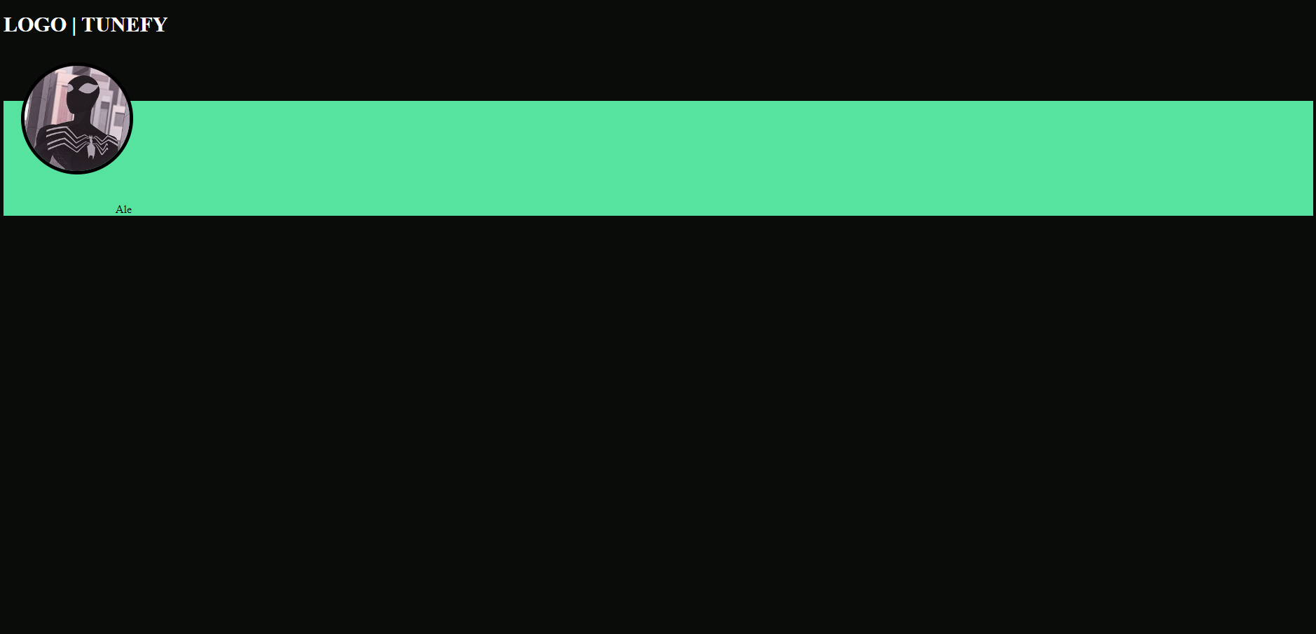
Current User Profile
Notes:
Alejandro

Slide 8
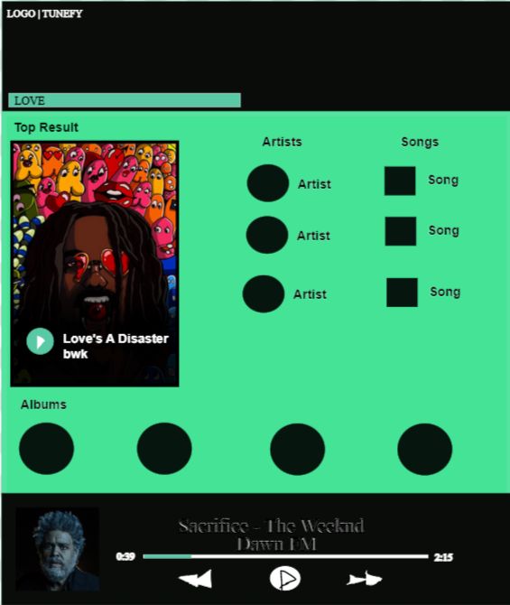
Wireframe - Search
- Search shows top result
- Also shows artists, songs, and albums that may correspond to searched item
Notes:
Cristian

Slide 9
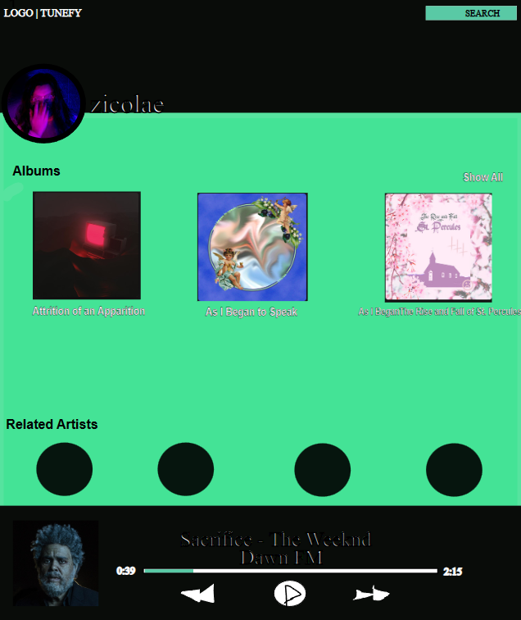
Wireframe - Artist Profile
- Displays most recent albums
- Shows related artists
Notes:
Alejandro

Slide 10
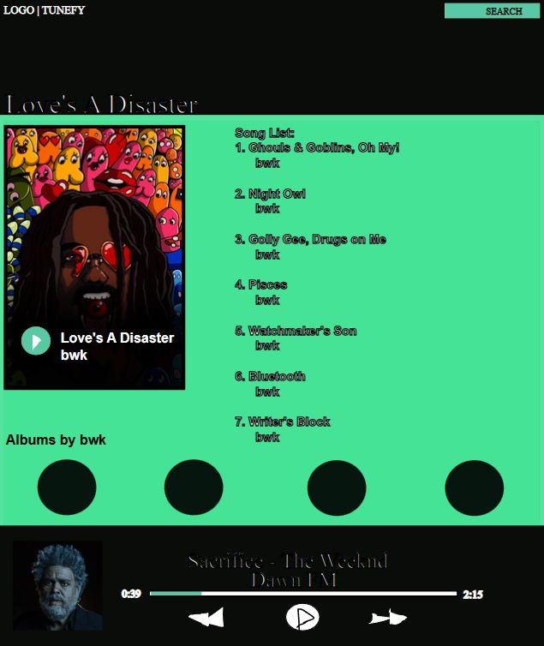
Wireframe - Album Page
- Shows other albums from the artist under the current album
- Ability to play specific songs from the album
Notes:
Cristian

Slide 11
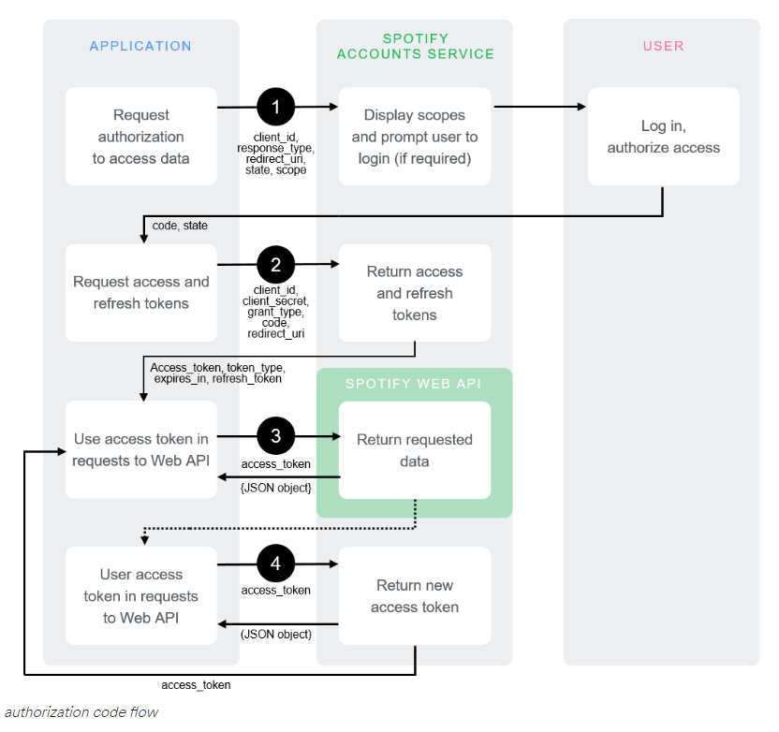
Spotify API
- Use to pull data:
Current Playback State
User Information
Top Tracks
- Spotify-web-api-node
- WIP:
useEffect() hooks to pull data https://developer.spotify.com/documentation/general/guides/authorization/code-flow/
https://github.com/thelinmichael/spotify-web-api-node
Notes:
Alejandro

Slide 12
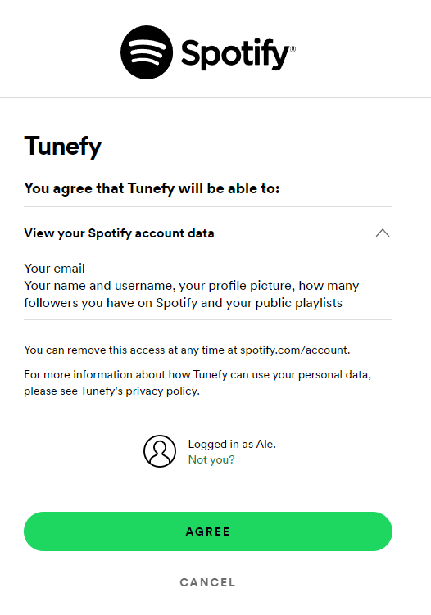
Authentication
- NextAuth.js is used to communicate with Spotify to easily get user info to sign up/login
- NextAuth.js also has the ability to easily refresh user tokens as Spotify Tokens expire in ~one-hour.
- Ability to sign out of the site (WIP)
Notes:
Cristian

